Slide 1
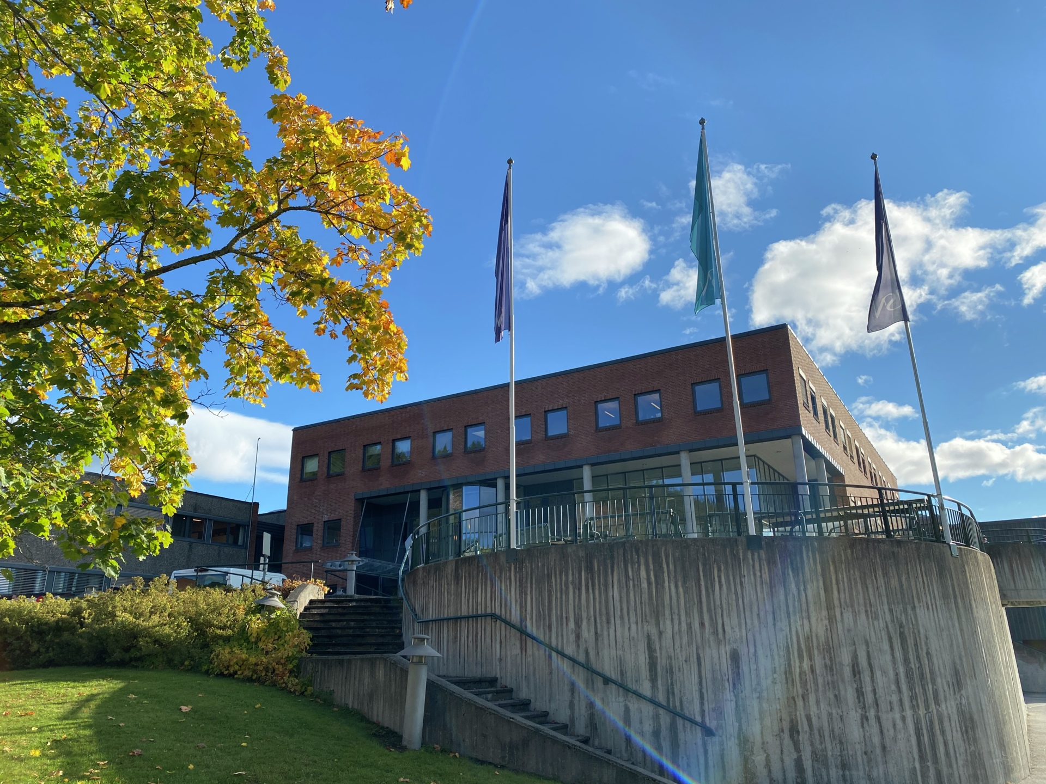

Cultural heritage: Issues of national identity, cultural tourism and education
Summer School
August 2022
Summer School
-
Join us for
Joint International Summer School
1-19 August 2022

Slide 2
Cultural heritage: Issues of national identity, cultural tourism and education
Summer School
On campus in Notodden (Norway) 5-12 August
University of Silesia (Poland), University of Turku (Finland), Linköping University, (Sweden) University of Iceland, University of South-Eastern Norway and UCL University College (Denmark) are pleased to invite our bachelor and master students to join our joint “hybrid” Summer School, this summer. The theme is especially suited for students or professionals with interest in a cross-disciplinary approach to cultural heritage and hands-on application of cultural heritage in your studies or profession. This could be students of Teacher Education, Social Education, Pedagogy, Cultural Studies, Arts and Cultural Management, Social Work, Future Studies, and interdisciplinary Social Sciences and Humanities, as well as disciplines related to the field of Tourism.
The three-week summer school is planned for 1 -19 August 2021 as an online – onsite – online learning experience. The onsite week takes place in Notodden, Norway from 8-12 August 2022. The summer school is a 5 ECTS course taught in English for students from across multiple disciplines and countries.
The summer school will give participants tools, knowledge and skills concerning cultural heritage, which can be applied in a comprehensive and reflexive way in future studies or professional work. The course content will focus on cultural heritage, including its definitions, manifestations, and use.
The course will particularly discuss cultural heritage in relation to four key topics:
General and cross-cutting issues concerning cultural heritage,
The relationship between cultural heritage and identity/national identity,
The relationship between cultural heritage and cultural tourism/destination development, and
The relationship between cultural heritage and education

Slide 3
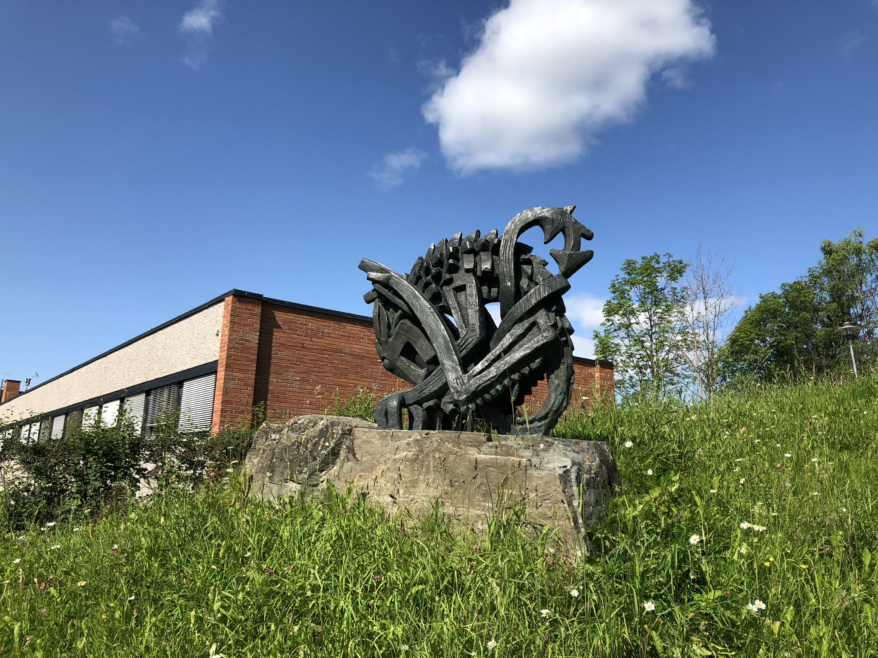

Cultural heritage: Issues of national identity, cultural tourism and education
Come visit Norway with a week’s stay at the Industrial Heritage town Notodden, right in the centre of Unesco World Heritage

Slide 4
Cultural heritage: Issues of national identity, cultural tourism and education
Summer School
Teaser from the programme:
Grounded and experience based learning
Exploring the industrial heritage of the Rjukan-Notodden World Heritage through extensive excursions
Dialogue with heritage stakeholders in Notodden
Visit to Heddal Stavechurch and exploring Viking and medieval heritage in the Nordics
And much, much more…
Practical information:
Contact your local coordinator to apply
Deadline for applications is 27.04.2022
Questions? Feel free to contact jaroslaw.gasior@us.edu.pl
Or
Karl Christian Alvestad (USN, NO) KARL.C.ALVESTAD@USN.NO
University of Silesia (Poland), University of Turku (Finland), Linköping University (Sweden), University of Iceland, University of South-Eastern Norway and UCL University College (Denmark) are looking forward to seeing you in August in Notodden, Norway.

